Slide 1




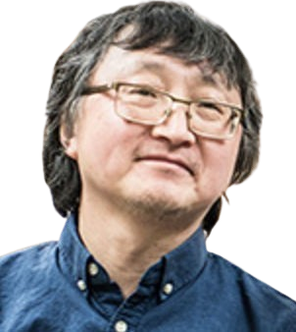
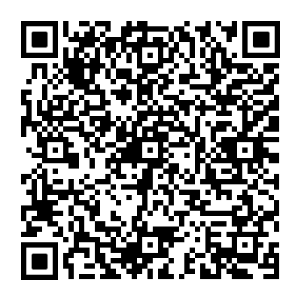

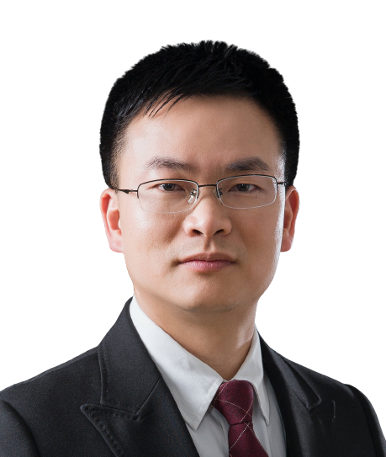
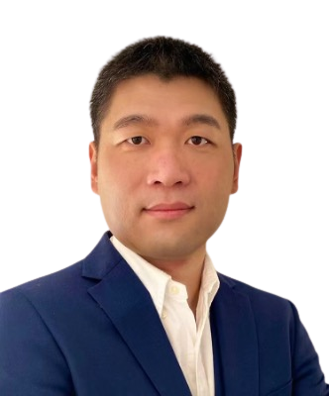
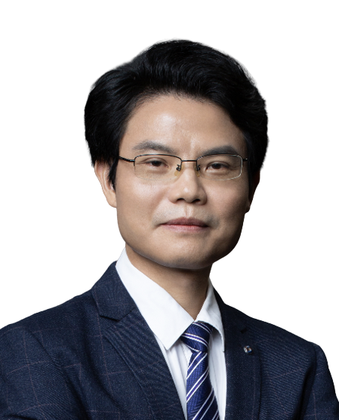
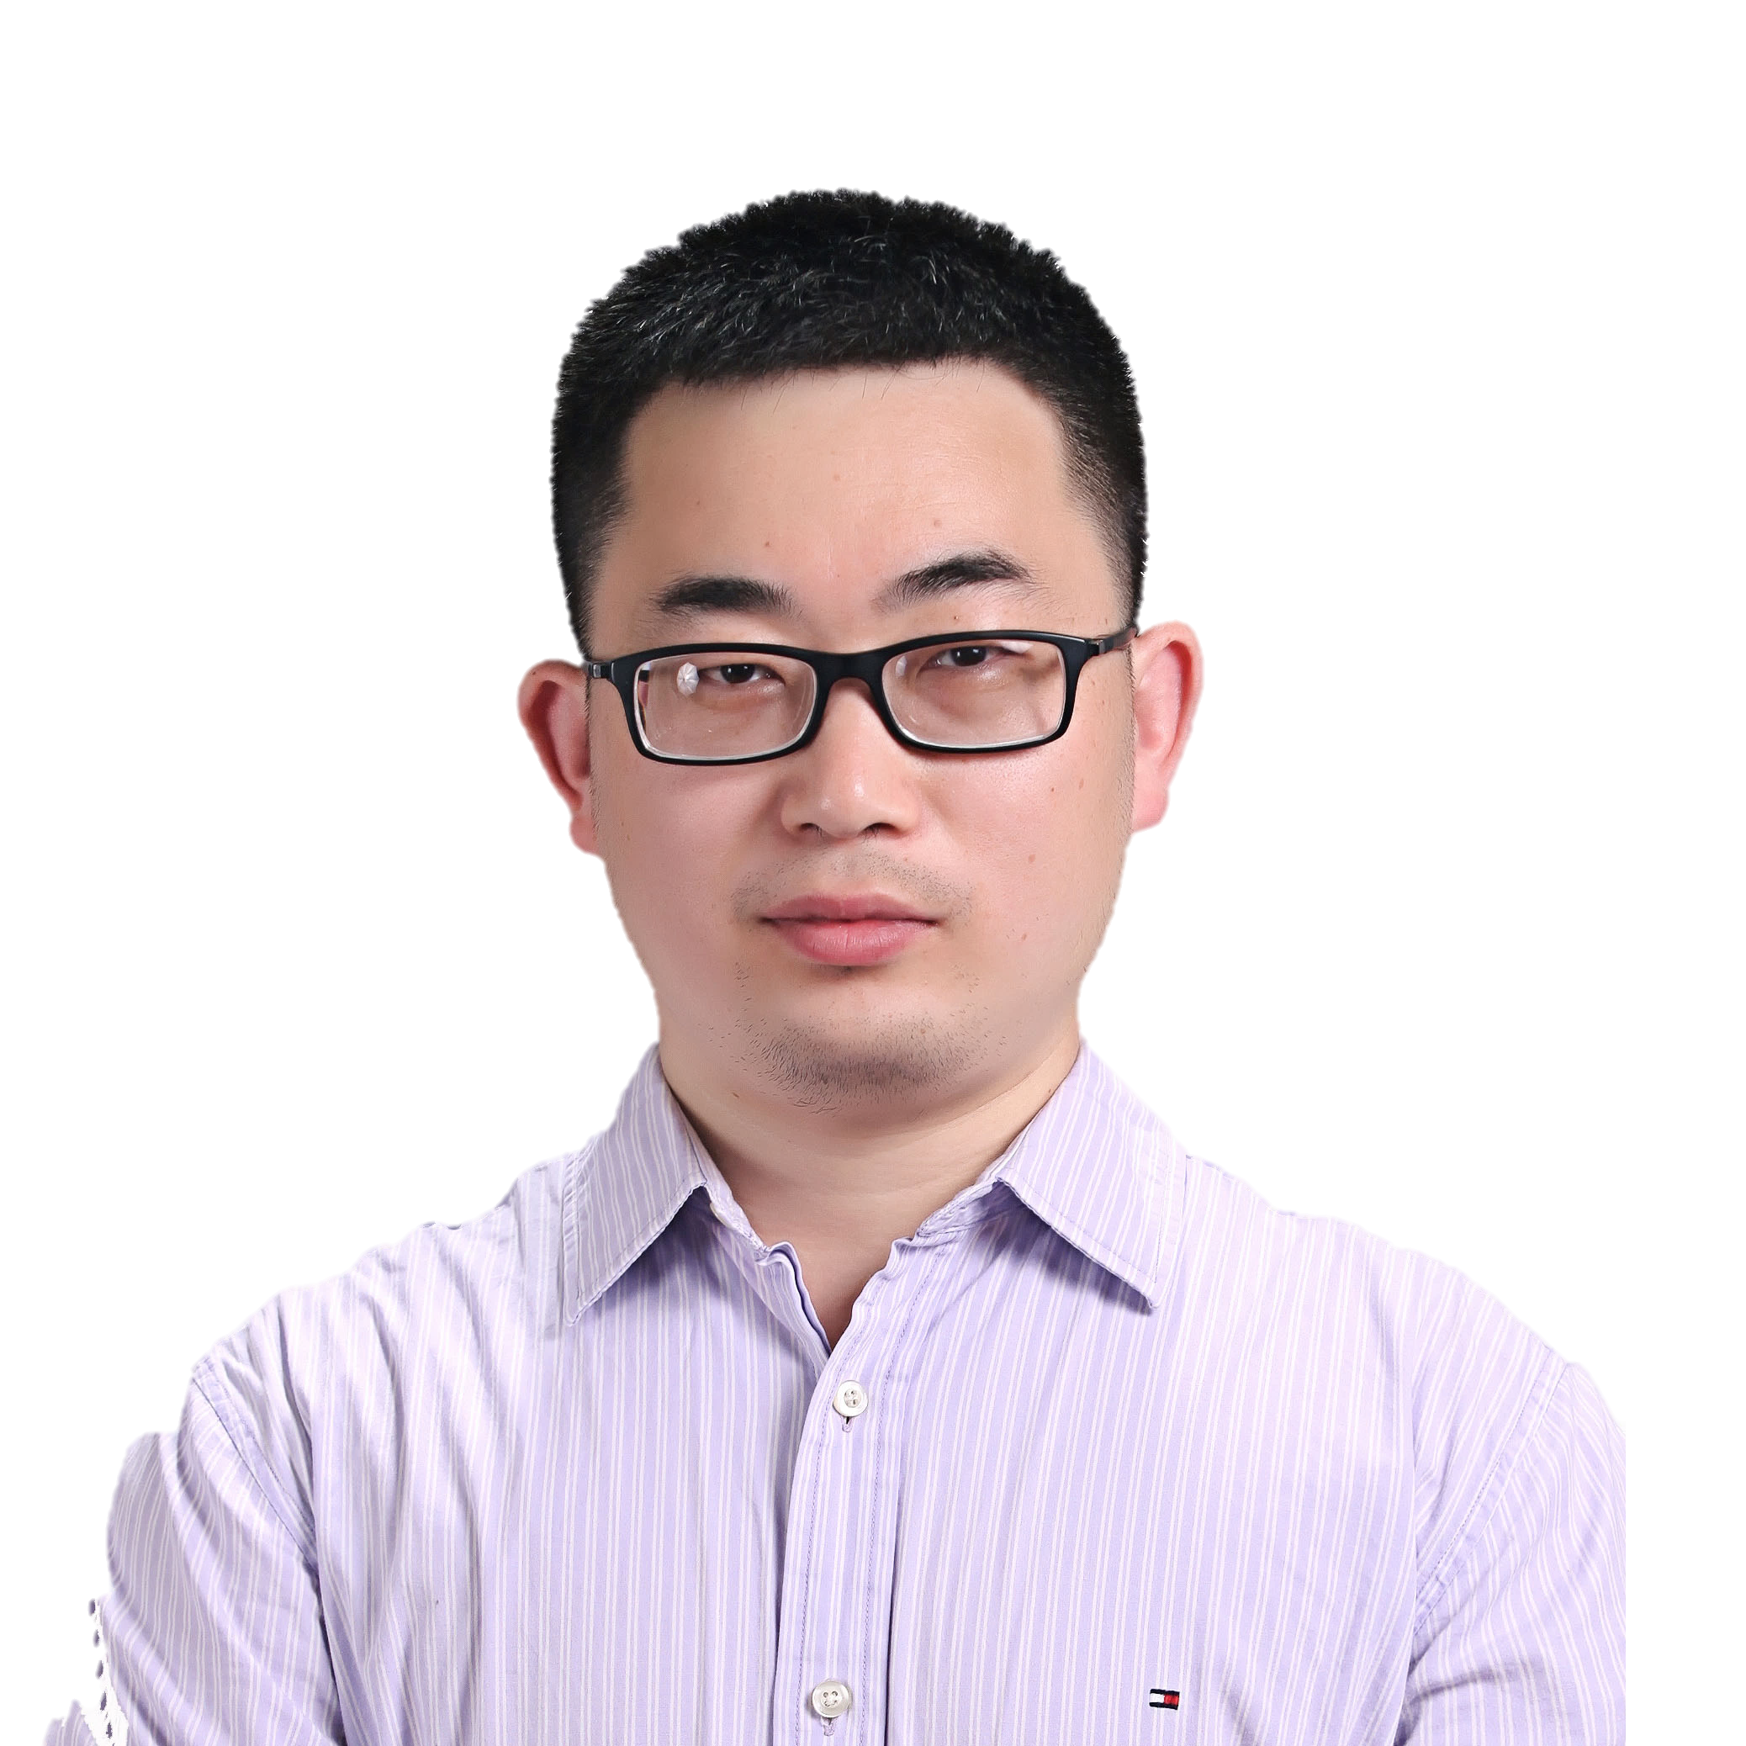
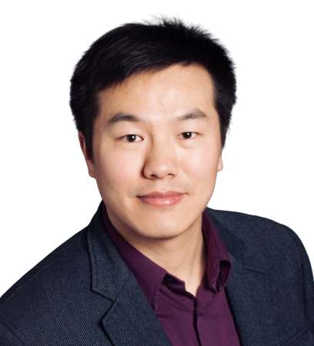



Decoding and investigating the epitranscriptome with new tools
Guangzhou Time：2024-03-29 09:00-11:00 AM
Chicago Time: 2024-03-28 20:00-22:00 PM
Meeting ID: 858 4618 2280
Meeting password: 123456
Bilibili： https://live.bilibili.com/26427894
Tao Pan
The University of Chicago
Professor of Biochemistry and Molecular Biology
Researcher Tao Pan Profile:
Professor of Biochemistry and Molecular Biology Committee on Genetics, Genomics and Systems Biology
Committee on Microbiology
Research and Scholarly Interests: epitranscriptomics, Functional genomics, Microbiome, RNA modification, tRNA.
He received his Ph.D. from Yale University in 1990, and became Cancer Research Foundation, Raymond F. Zelko Young Investigator in 1994, a Fellow of the American Association for the Advancement of Science (AAAS) in 2015. He received several grants and honors, including the Damon Runyon-Walter Winchell Cancer Research Fund, the American Cancer Society, Junior Faculty Research Award, the National Institutes of Health (NIH) EUREKA Award, and the NIH Director's Pioneer Award.
Abstract：
Epitranscriptomics refers to chemical changes in cellular RNA and includes many chemical types with varying stoichiometry and functions. Human RNA contains about 40 modification types in tRNA and about 10 in mRNA. Tao Pan will discuss recent technology development and biological investigations in his lab that utilize nanopore sequencing for mRNA modifications, and illumina sequencing for tRNA modifications.
HOST＆PANELISTS
Host: Lin Huang
Sun Yat-Sen Memorial Hospital,
Sun Yat-Sen University
Zhichao Miao
Guangzhou Laboratory
Guangzhou Medical University
Jianhua Yang
Sun Yat-Sen University
Jinkai Wang
Zhongshan School of Medicine,
Sun Yat-Sen University
Xiaoyun Wang
Guangzhou Institute of Biomedicine and Health, Chinese Academy of Sciences
Sponsors

Slide 2


利用新工具解码和研究表观转录组
报告广州时间：2024-03-29 09:00-11:00 AM
芝加哥时间： 2024-03-28 20:00-22:00 PM
ZOOM会议ID: 858 4618 2280
会议密码：123456
Bilibili： https://live.bilibili.com/26427894
潘 滔
芝加哥大学
生物化学与分子生物学系教授
潘滔教授简介：
潘滔，现任芝加哥大学生物化学与分子生物学教授，主要研究兴趣为表观转录组学、功能基因组学、微生物组学、RNA修饰和tRNA等。1990年取得耶鲁大学博士学位、在1994年成为癌症研究基金会Raymond F. Zelko青年研究员、2015年成为美国科学促进会（AAAS）研究员，获得Damon Runyon-Walter Winchell 癌症研究基金、美国癌症协会初级教师研究奖、美国国立卫生研究院EUREKA奖、美国国立卫生研究院院长先锋奖等多项基金及荣誉。
讲座摘要：
表观转录组学是指细胞RNA中的化学修饰变化，其中包括许多具有不同化学计量和功能的化学修饰类型。人类RNA在tRNA中含有大约40种修饰类型，在mRNA中含有大约10种修饰类型。潘滔教授将讲述他实验室中利用纳米孔测序进行mRNA修饰检测和illumina测序进行tRNA修饰检测的最新技术发展和生物学研究。
HOST＆PANELISTS
主持人：黄 林
中山大学孙逸仙纪念医院
苗智超
广州实验室
广州医科大学
杨建华
中山大学
王金凯
中山大学中山医学院
汪肖云
中国科学院
广州生物医药与健康研究所
Sponsors

